Slide 1
Unlocking Learning: A Deep Dive into Udemy Course Trends and Insights
Shubhang Yadav Sandaveni

Slide 2

Unlocking Learning
Udemy is a leading e-learning platform with thousands of courses across diverse topics. However, its vast dataset is fragmented, making it challenging to extract meaningful insights. Our goal was to tackle this challenge by creating a centralized data warehouse, enabling structured analysis of pricing, content preferences, instructor performance, and user feedback. By doing so, we empower Udemy to make data-driven decisions that enhance learner satisfaction and revenue generation.

Slide 3
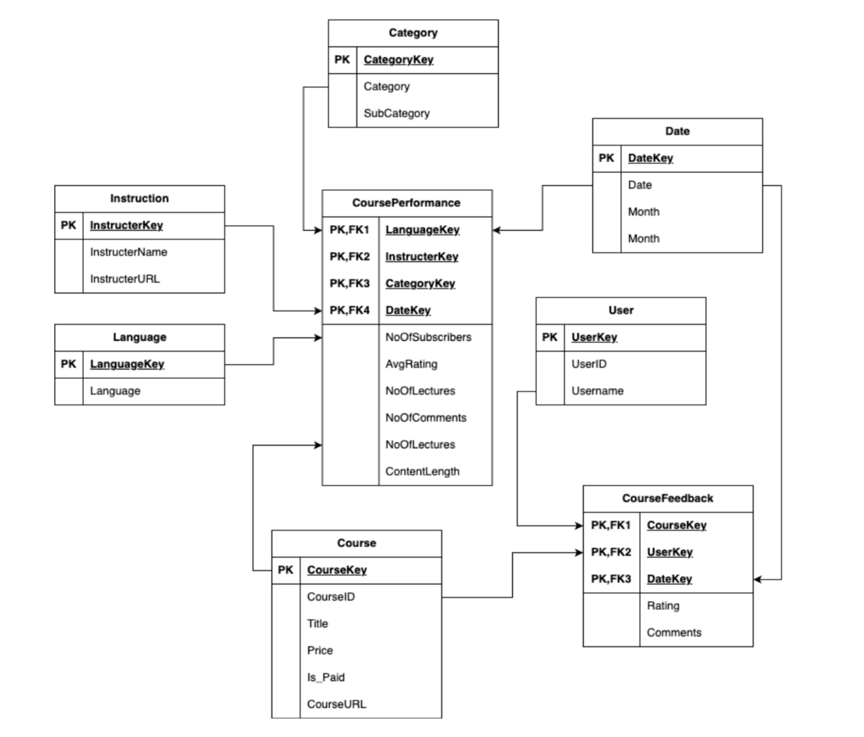
Structured Data for Actionable Insights
Data Sources:
Kaggle:https://www.kaggle.com/datasets/hossaingh/udemy-courses?select=Course_info.csv
Schema design

Slide 4
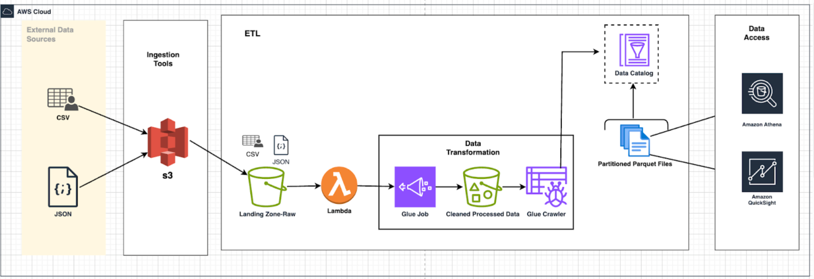
From Raw Data to Actionable Insights

Slide 5
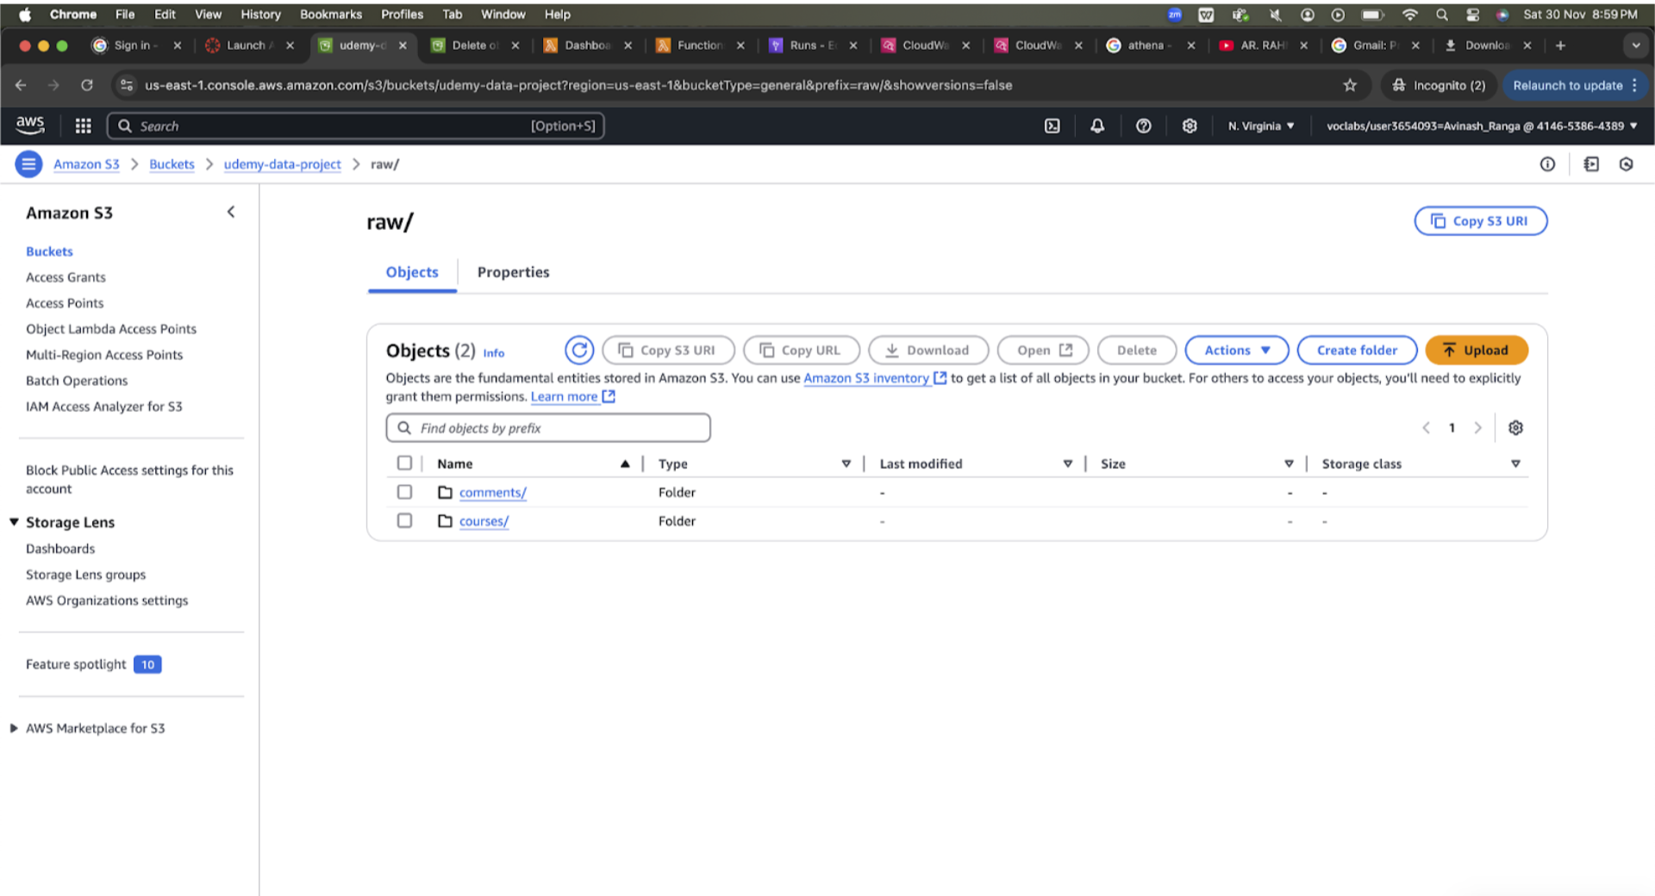
Data Ingestion
Raw datasets (Comments.csv and Courses_info.json) are uploaded to AWS S3.

Slide 6
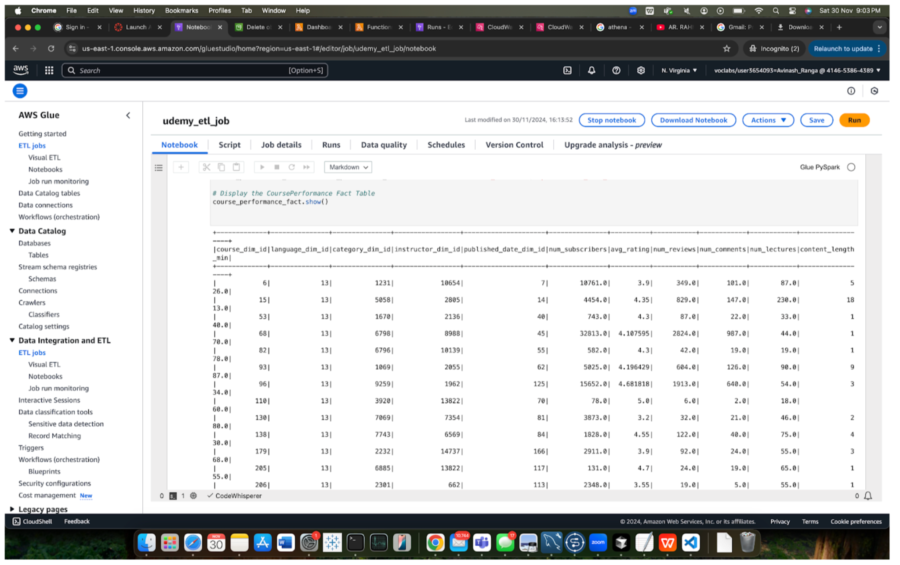
Data Transformation
AWS Glue processes the raw data into structured fact and dimension tables.Null values are cleaned, and consistent formats are enforced.

Slide 7
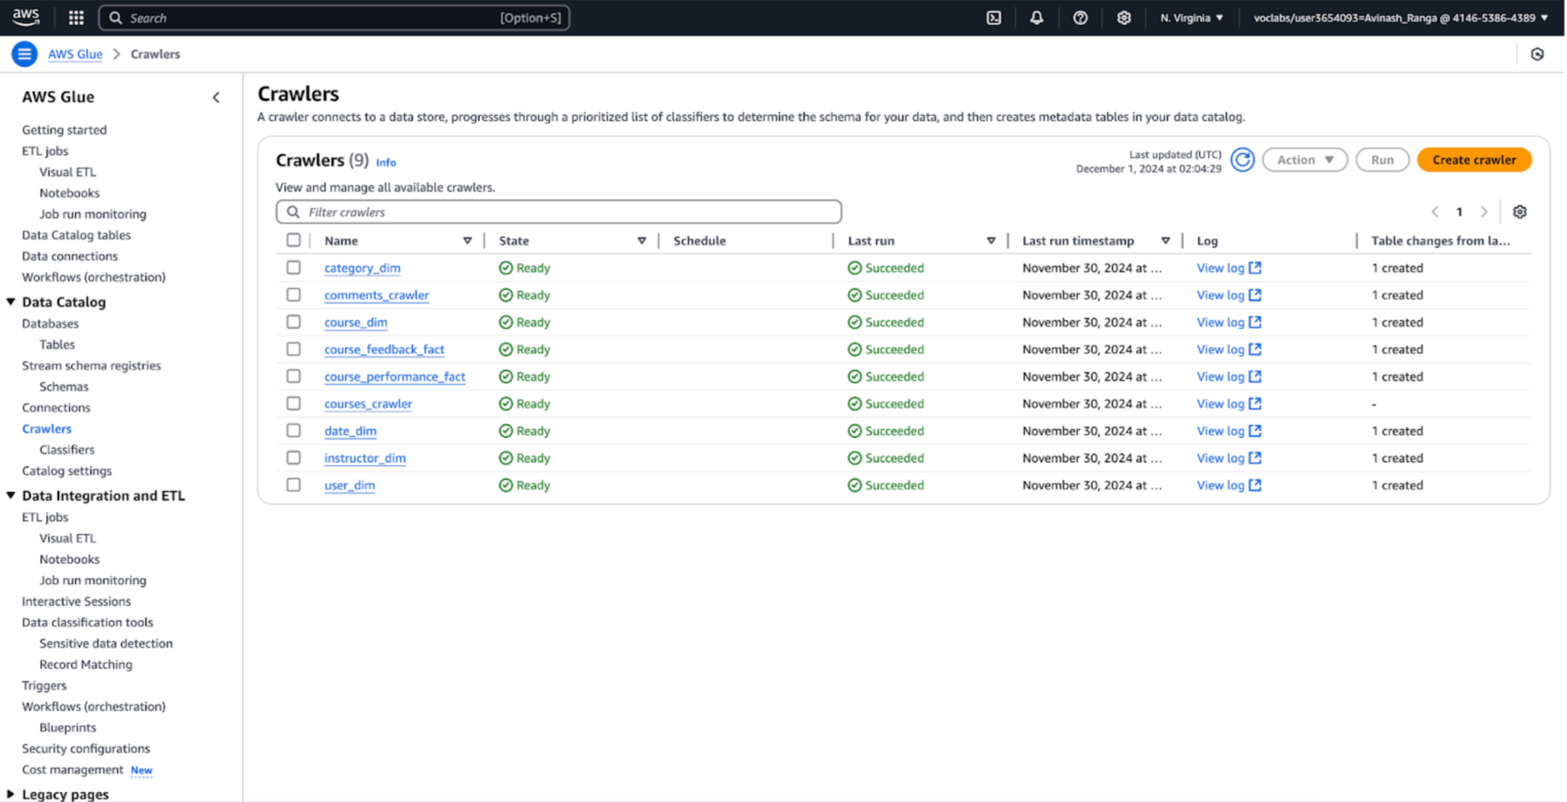
Data Loading
Glue Crawlers create Athena-compatible metadata tables for querying.

Slide 8
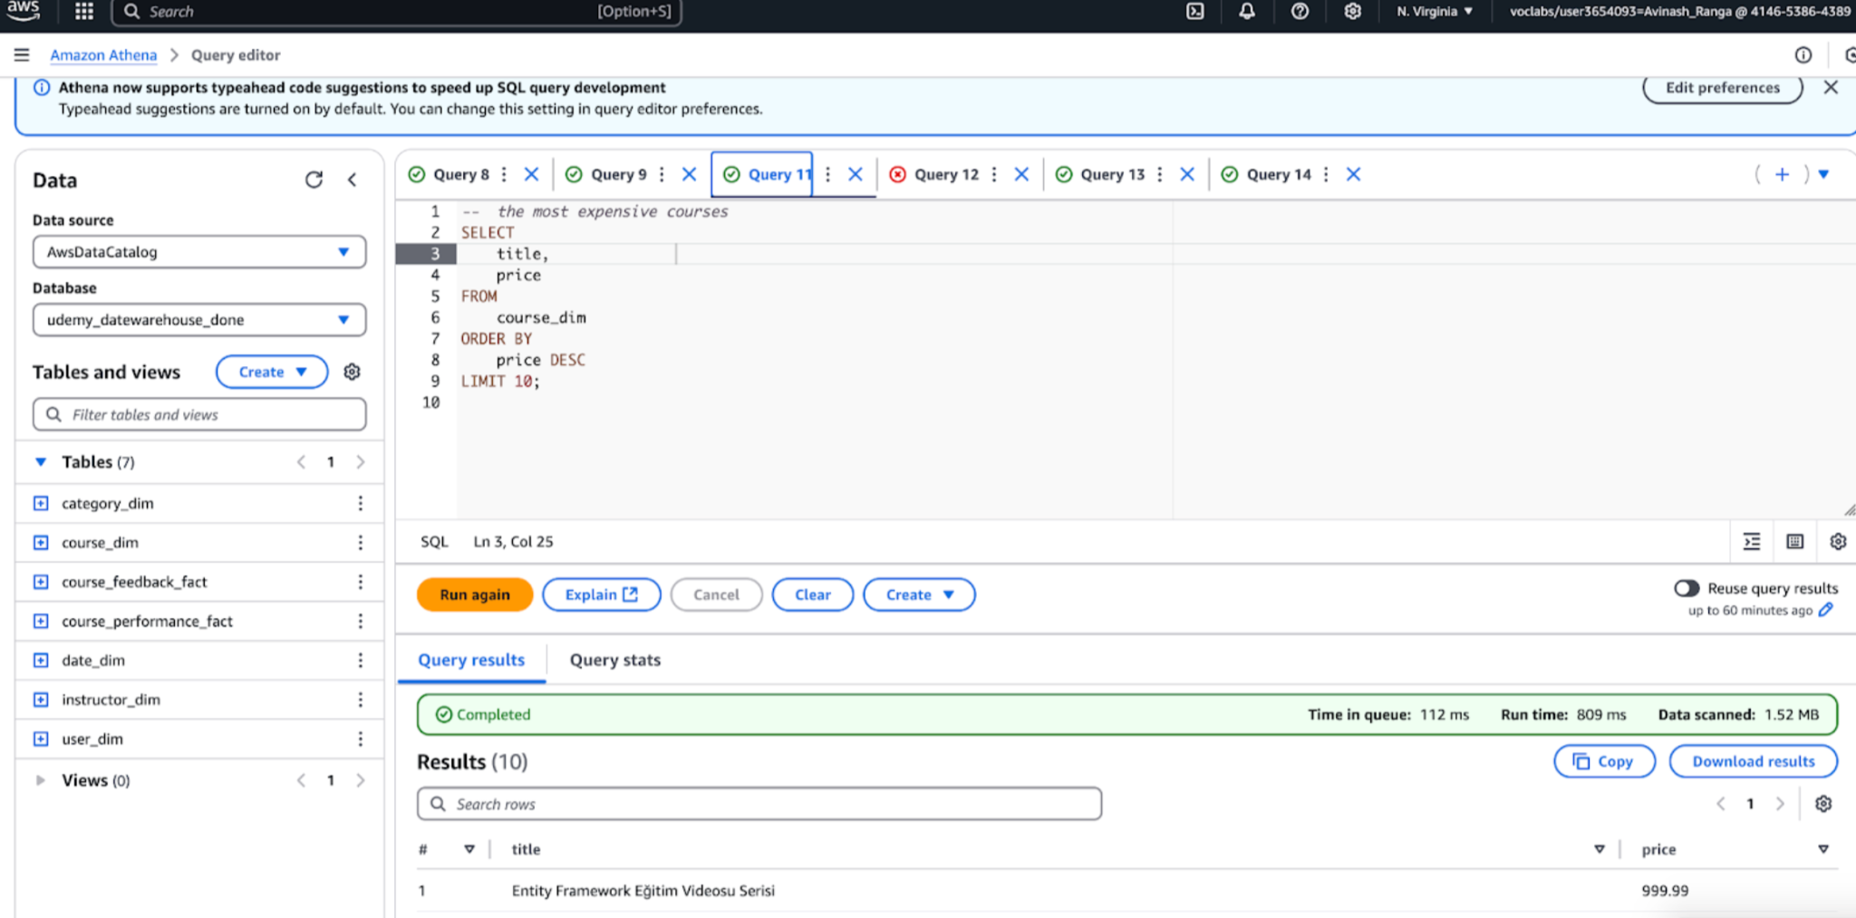
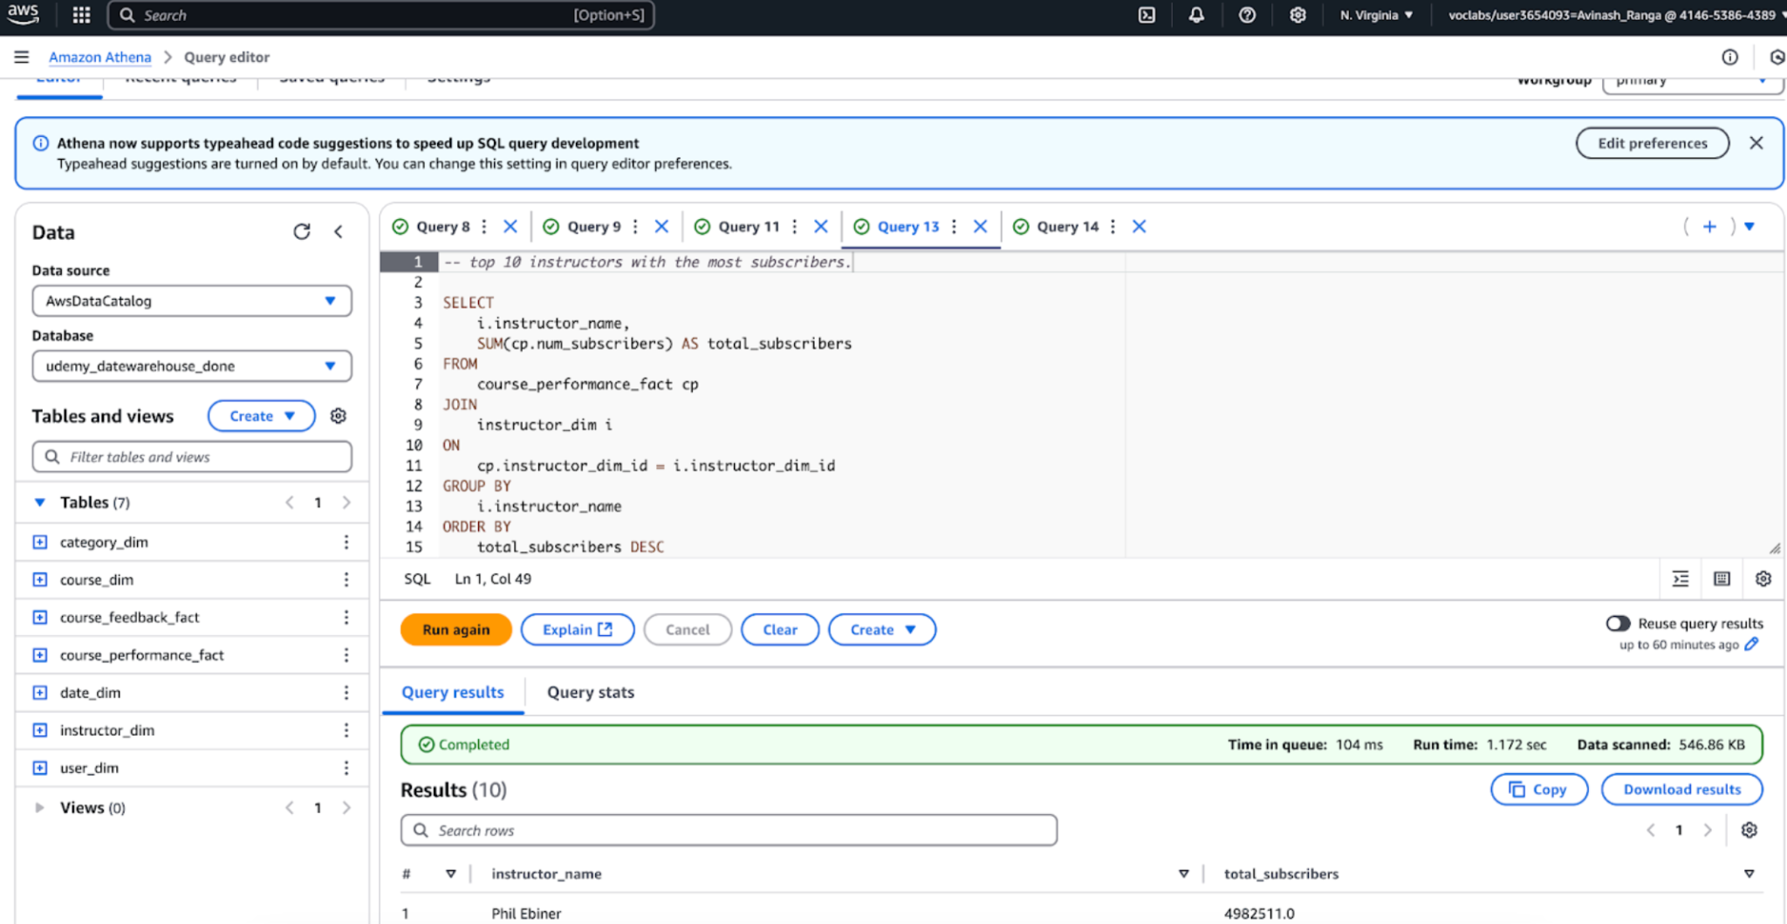
Data Analysis
Processed data is queried using Athena

Slide 9
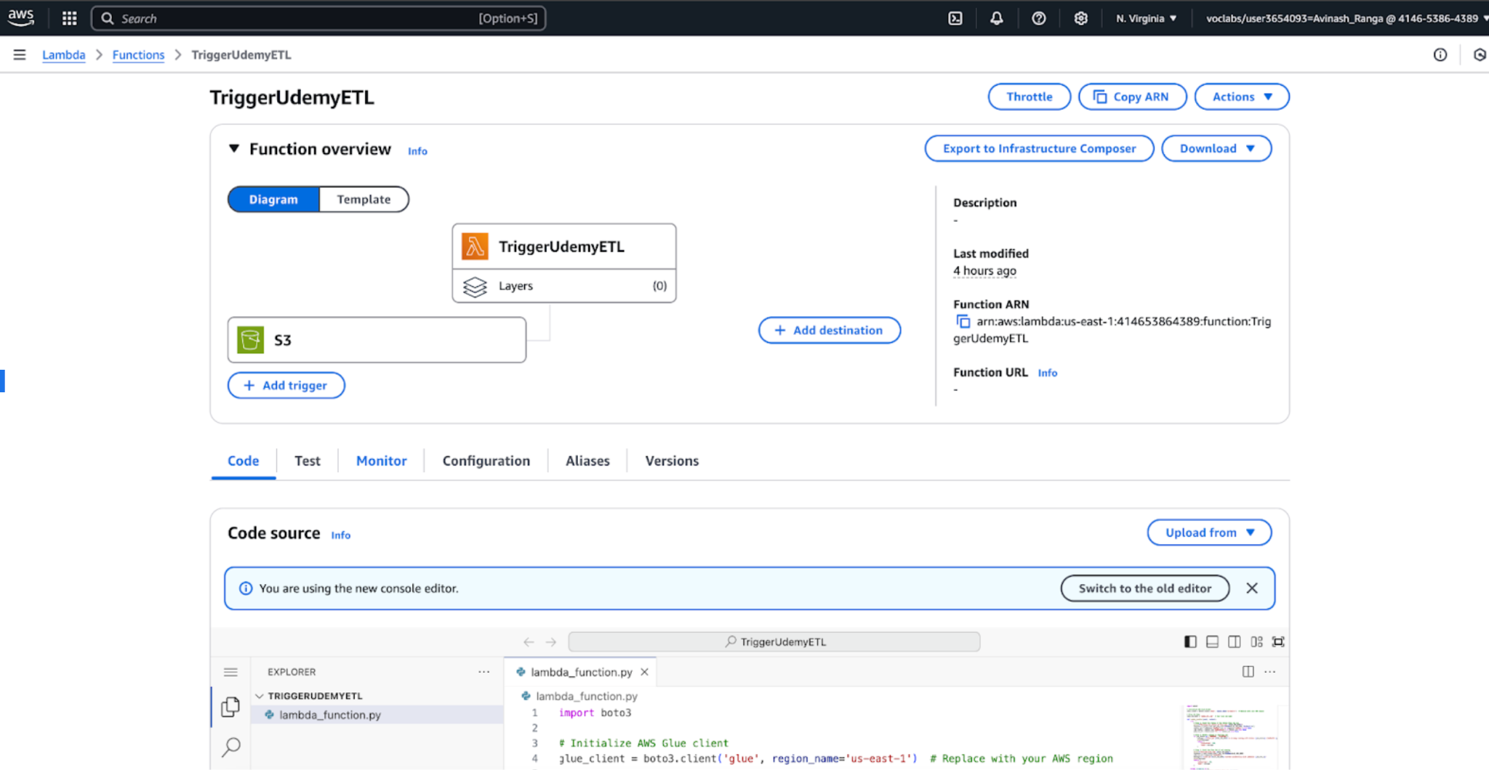
Pipeline Automation
Steps:
S3 Monitoring:
Lambda detects file uploads in the raw folder of the S3 bucket.
Glue Trigger:
Automatically starts the Glue ETL job to process new data.
Data Transformation:
Glue processes the data into structured fact and dimension tables.
Error Handling:
Lambda tracks Glue job status and logs errors for troubleshooting.
Benefit:
Fully automated pipeline minimizes manual intervention, ensuring real-time updates and consistent processing.

Slide 10
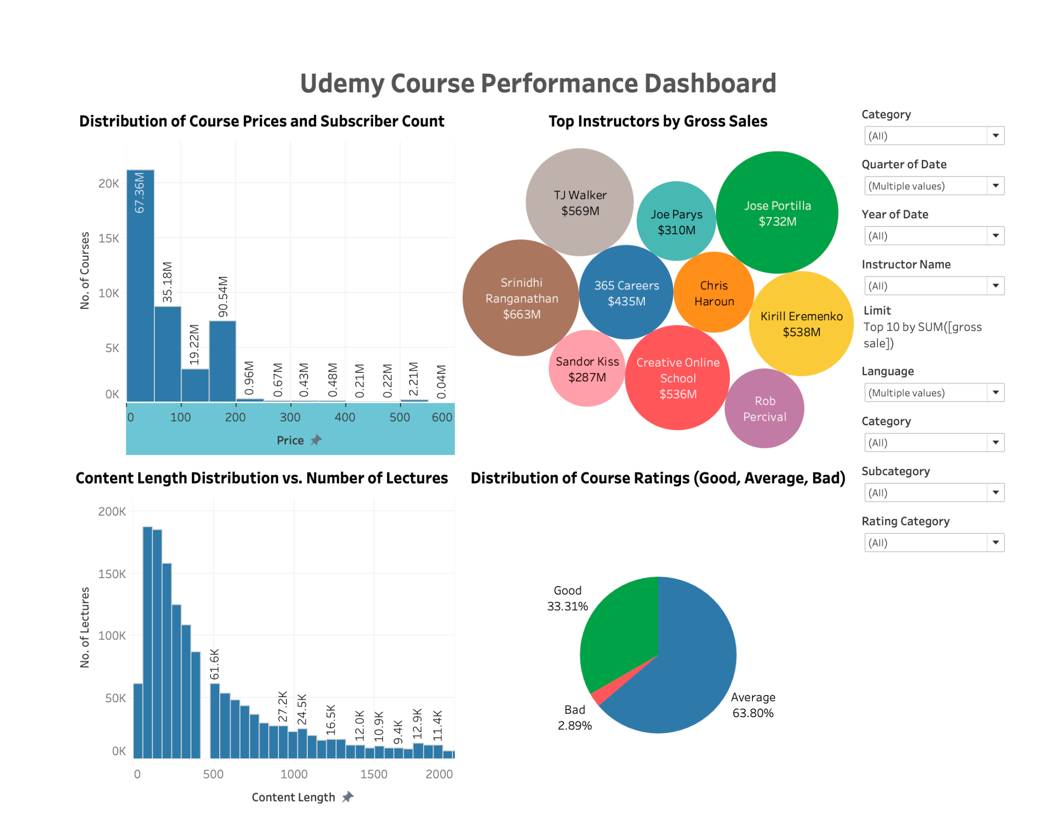
Dashboard Overview
Key Points:
Tableau dashboard provides a comprehensive analysis of pricing, content length, instructor revenue, and course quality.
Interactive filters enable category, date, and instructor-based exploration.

Slide 11
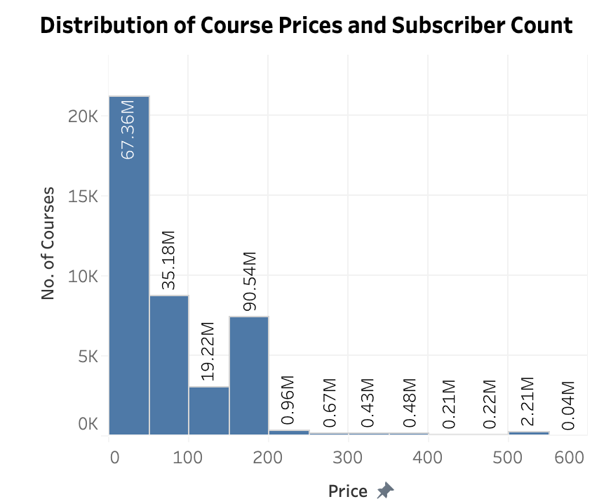
Pricing and Subscriber Engagement
Affordable Courses Drive Engagement
Focus KPIs:
Top Price Range: Courses under $100 attract the highest subscribers.
Engagement Decline: Premium courses ($500+) show significantly lower traction.
Insights:
Price-sensitive learners overwhelmingly prefer affordable pricing.

Slide 12
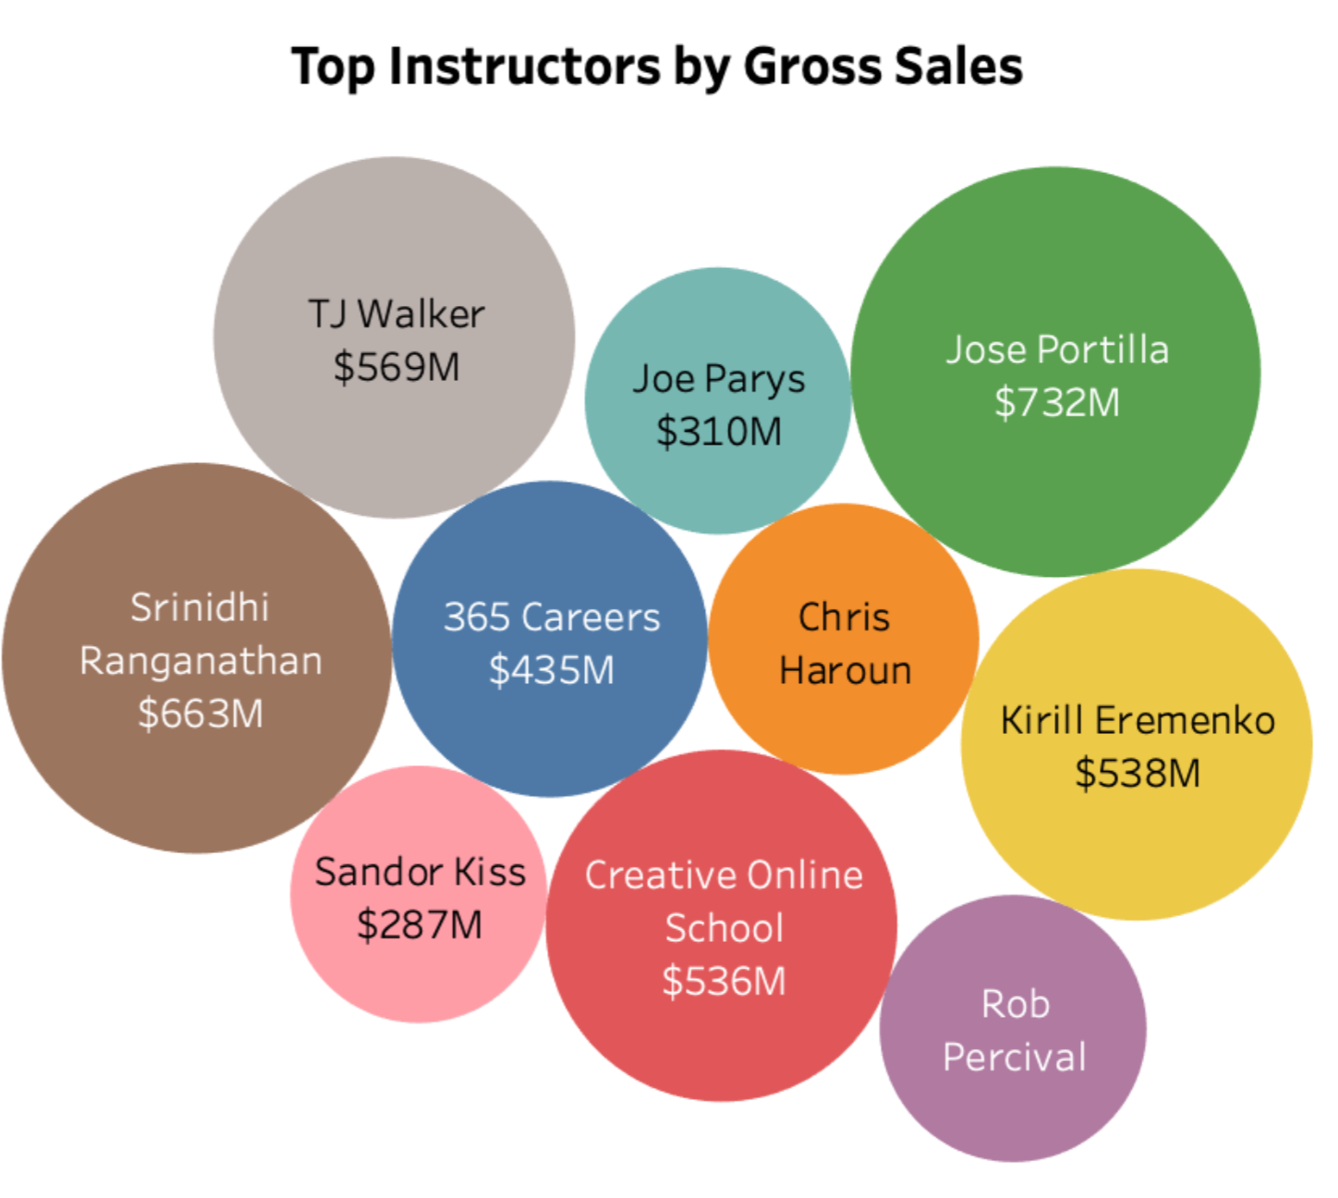
Top Instructors by Revenue
Revenue Concentration Among Instructors
Focus KPIs:
Top Performer: "Jose Portilla" leads with $732M, followed by "Srinidhi Ranganathan" at $663M.
Revenue Distribution: Top 10 instructors dominate earnings.
Insights:
Revenue concentration suggests the need to empower mid-tier instructors.

Slide 13
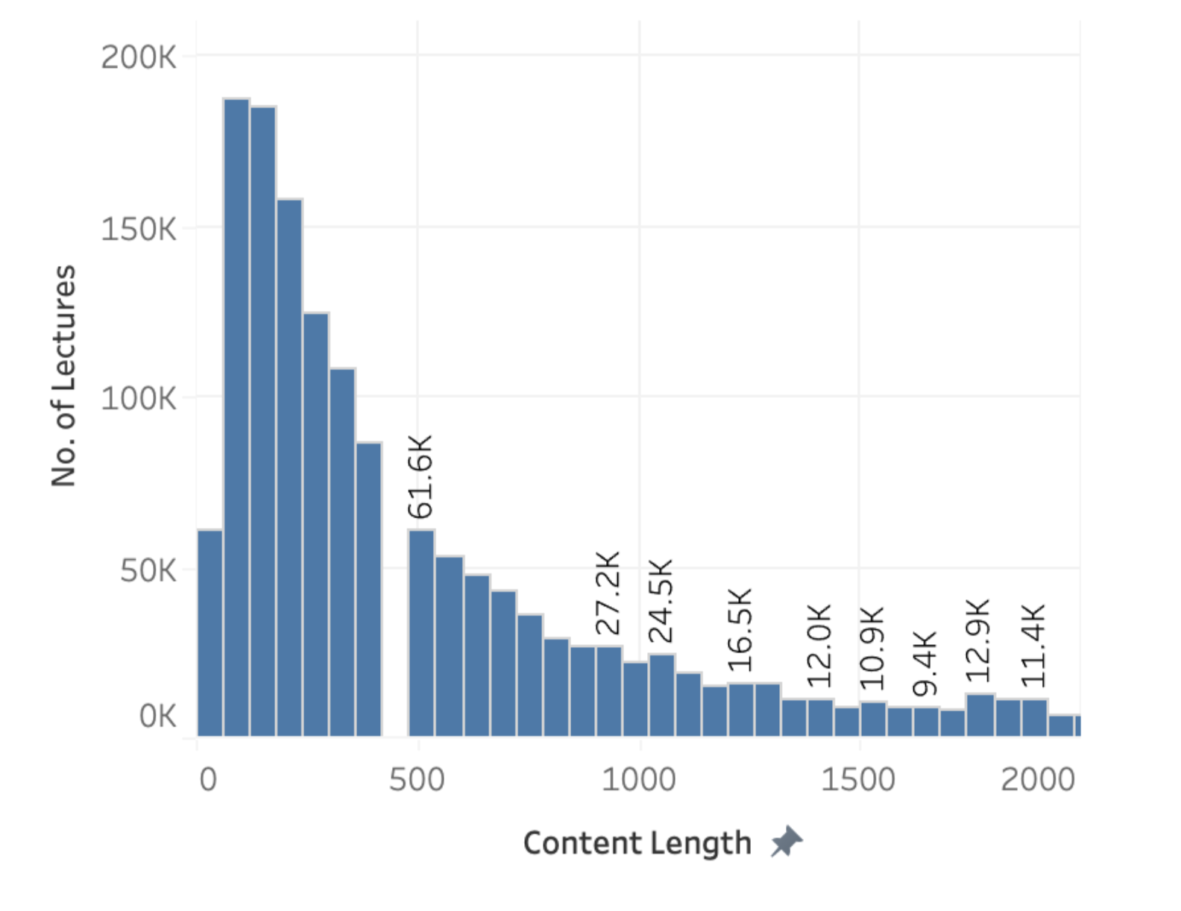
Content Length and Lectures
Learners Prefer Concise Content
Focus KPIs:
Optimal Content Length: Courses under 200 minutes dominate preferences.
Content Design: Longer courses (>1000 minutes) are less popular.
Insights:
Shorter courses align with learner preferences, guiding future course design.

Slide 14
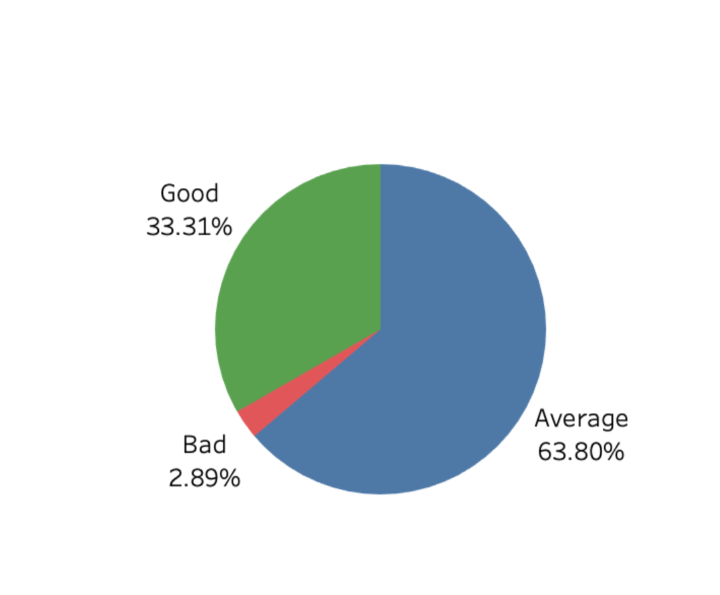
Course Quality Ratings
Improving Course Quality
Focus KPIs:
Good Courses: Only 33.3% of courses rated 4.5+ (Good).
Average Courses: 63.8% rated as Average, indicating a quality gap.
Insights:
Focus on improving "Average" courses to enhance learner satisfaction.

Slide 15
Conclusion
Key Achievements:
Automated and scalable pipeline ensures real-time data processing.
Actionable insights on pricing, content, and instructor contributions.
Future Scoping:
Predictive analytics for course success and pricing.
Sentiment analysis for deeper user feedback interpretation.
Real-time dashboards for immediate course optimization.

Slide 16
Thank You

